Slide 1

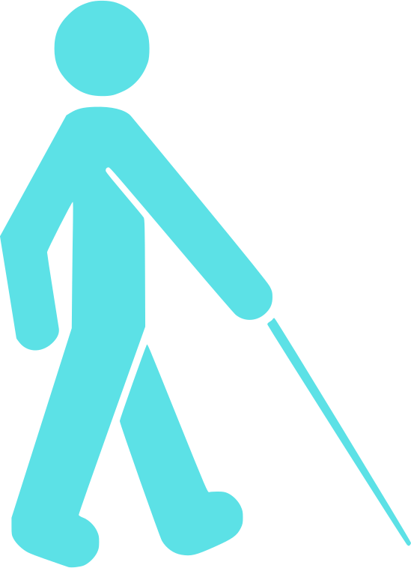
PROBLEM
Community are not sustainable for all.
People with disabilities cannot navigate cities independently
Poor urban design creates daily barriers
Lack of assistive technology limits mobility
Simple everyday tasks become difficult
This leads to inequality and loss of independence.

Slide 2
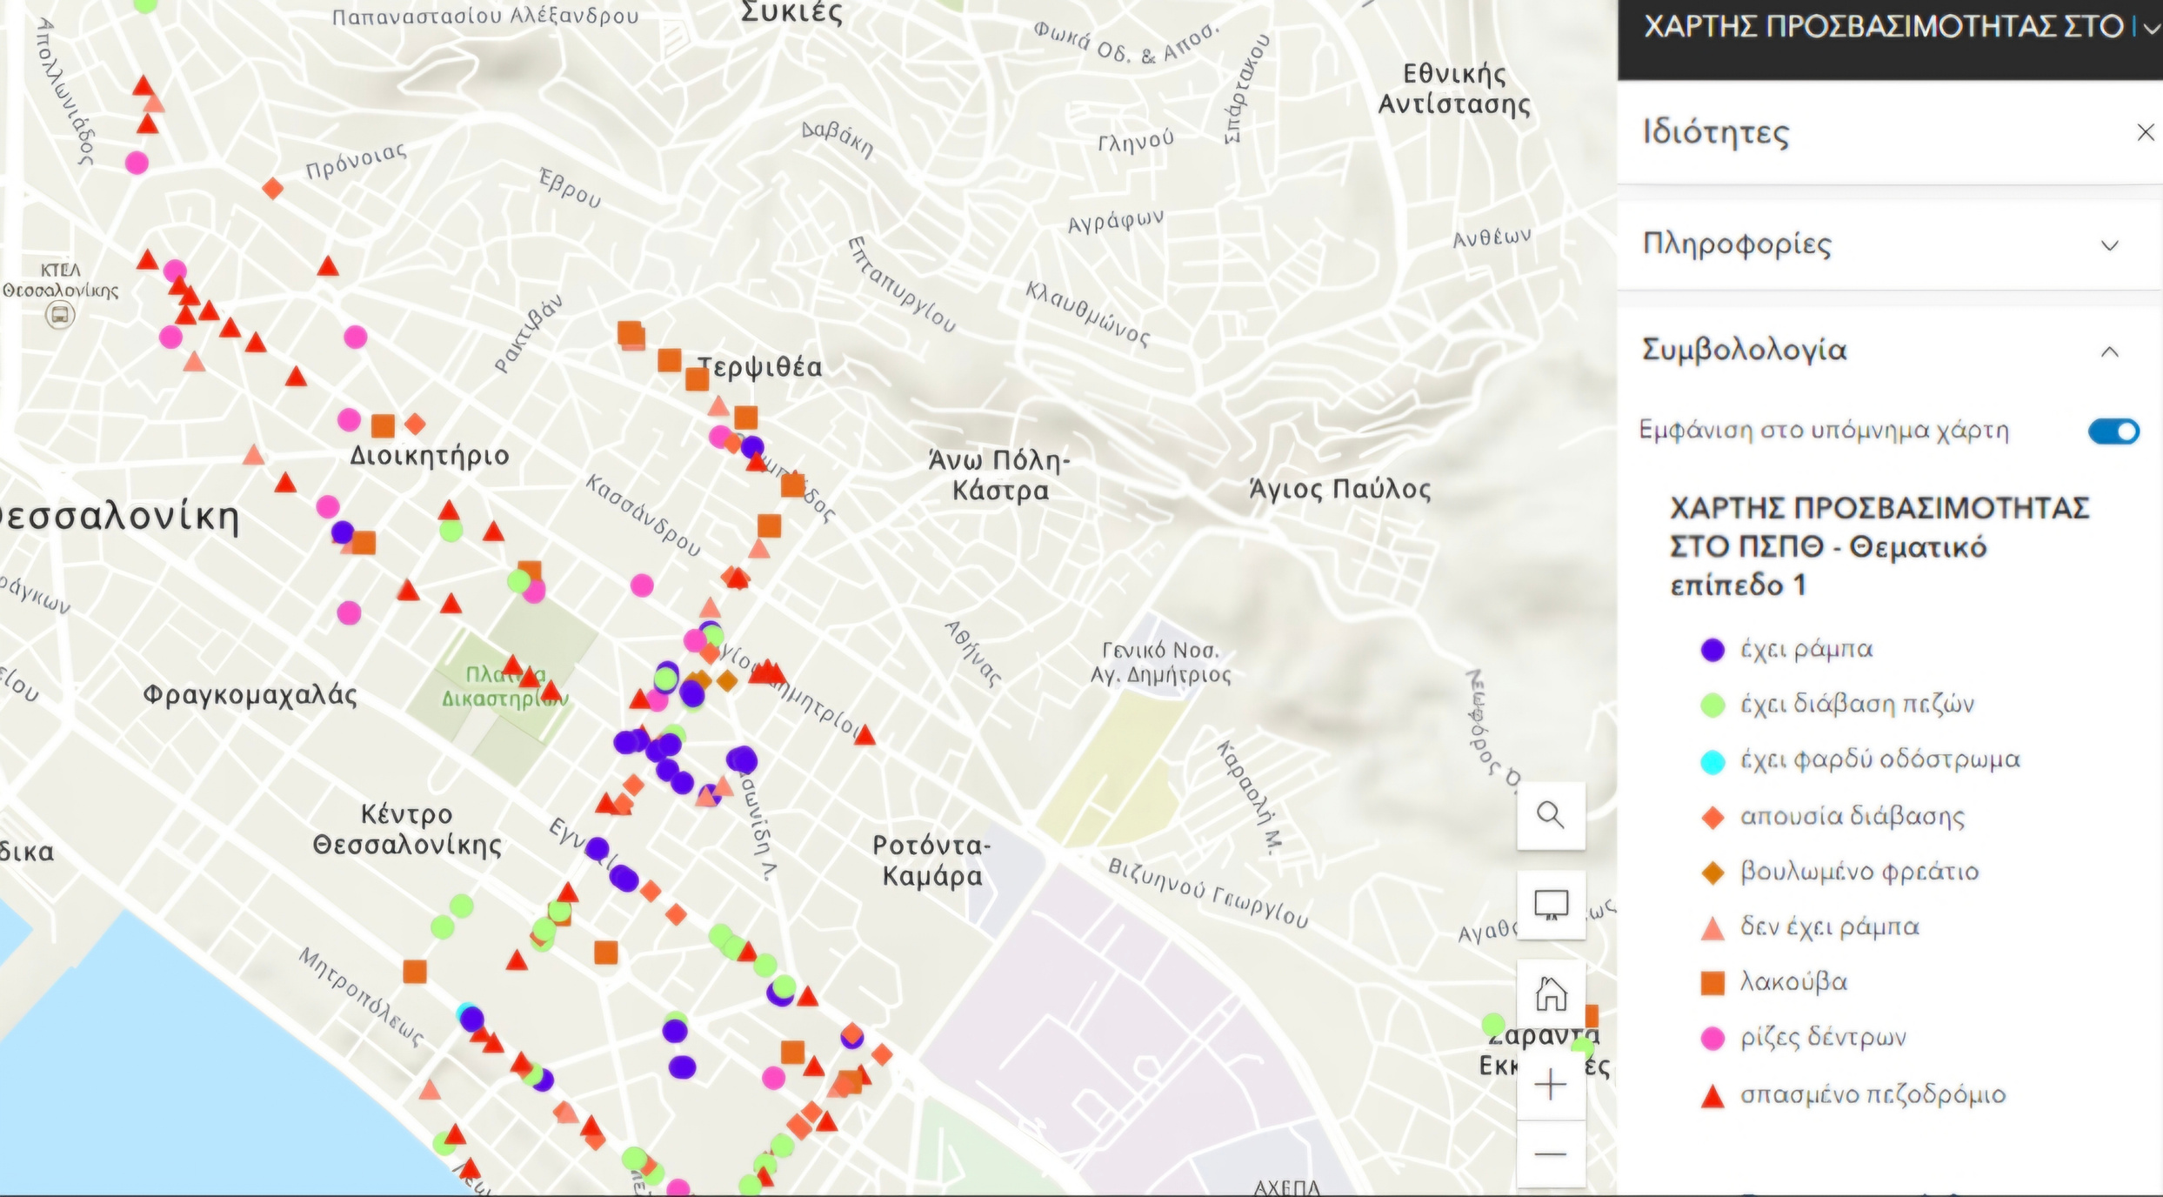
THE PROJECT
MachIne learning
In our tool AI Machine learning is uses to train models to recognize through ,the camera lence of a smart phone, the different signs of pedestrian lights.Then via a sound signal the sustem will inform its user about the signs.
ArcgIS -fIELD MAPS
EFFECT
We created an accessibility map using the arcGIS app that helps disabled people navigate through the city more efficiently.
Cities will become more sustainable and accessible for more citizens. Transportation becomes safer for disabled people and therefore allows all members of a community to grow and thrive.

Slide 3
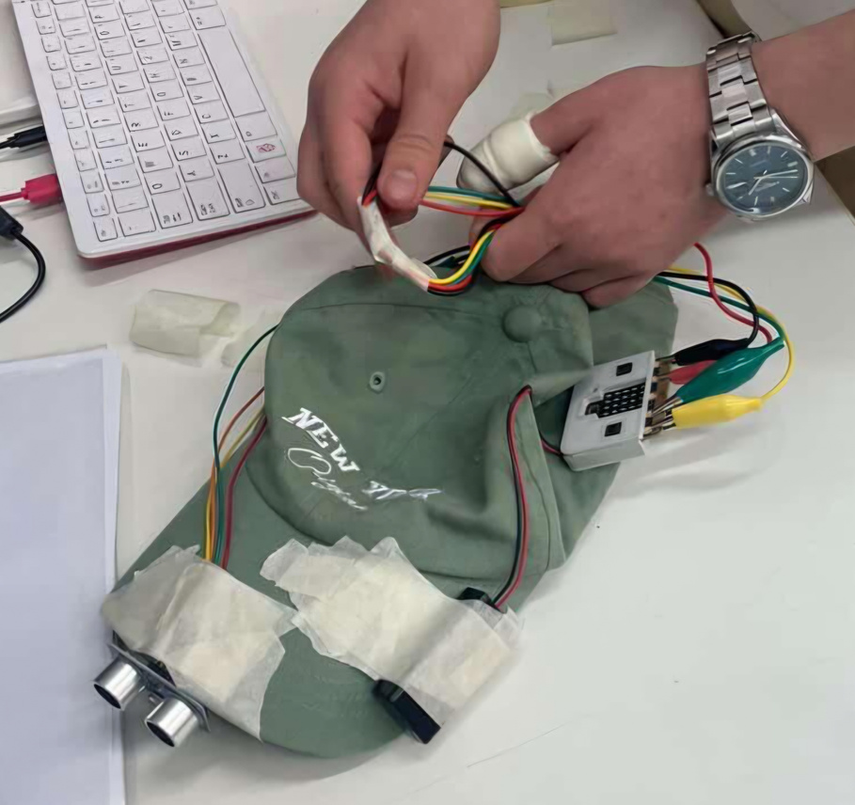
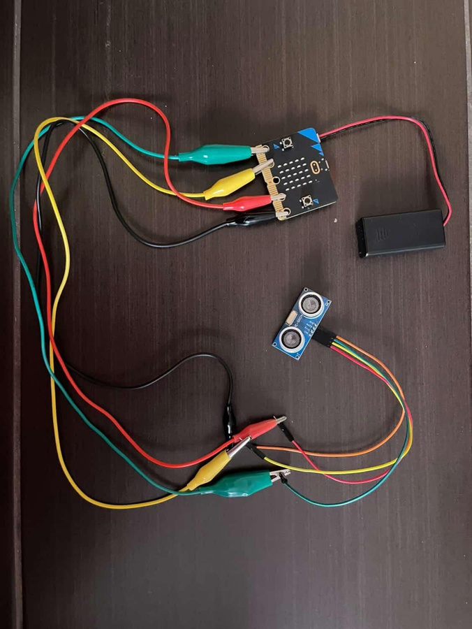
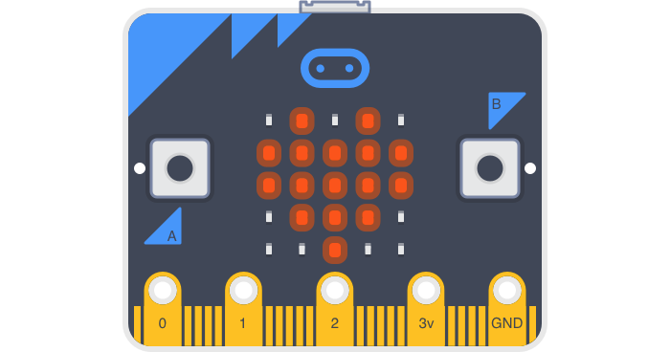
MATERIALS / SOFTWARE
MATERIALS
SOFTWARE
micro:bit
distance sensor
battery pack
phone
microbit case
microbit makecode
Teachable Machine
Lofi robot machine learning app
Tinkercad
The use of the phone as a camera makes this tool accesible and easy to use.

Slide 4
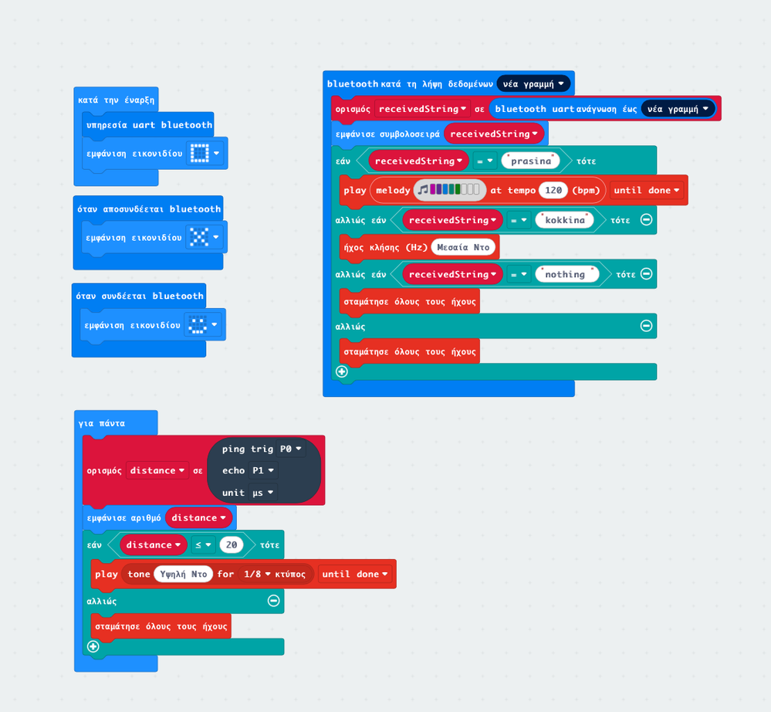

TIMELINE
1
Designing the idea of the project
2
Training the machine learning
3
Coding the microbit
4
ASSEMBLING THE HAT
5
RUNNING TESTS

Slide 5
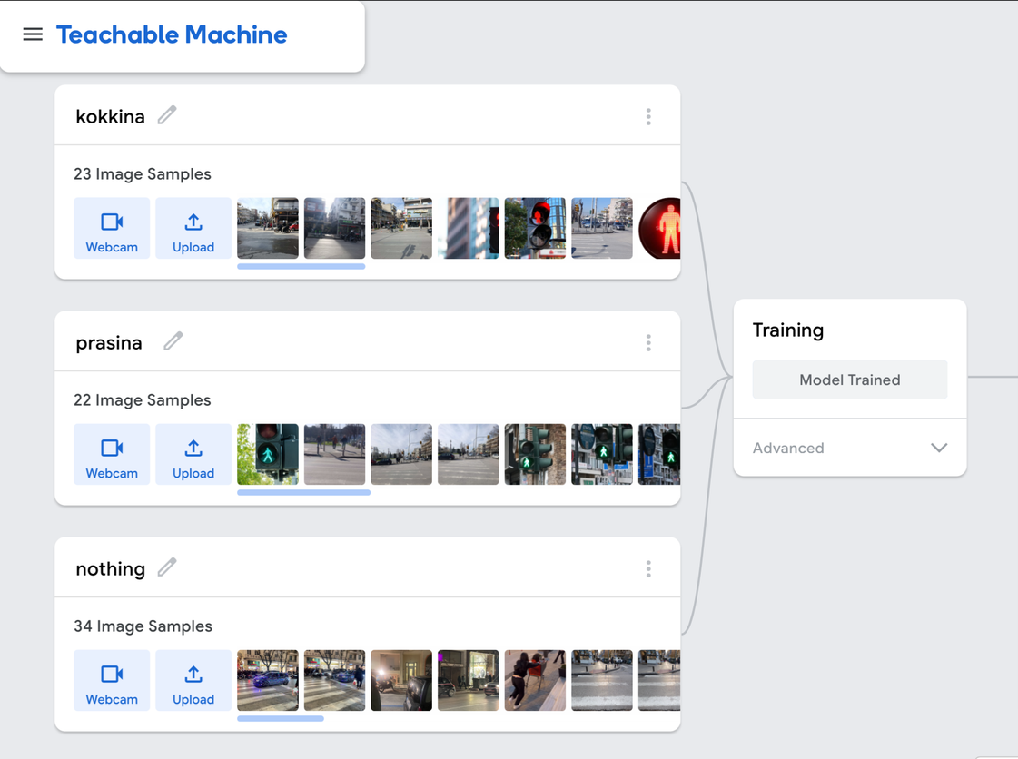
EVALUATION
SUCCESS
This project will be successeful only if it serves its purpose to help disabled people finaly get access everywhere safely, make communities sustainable for all and finaly give equal opportunities to all.
Assess
Through pilot simulations and tests
Experienced mechanics
Engagement/ Parterships
Reduction in accesibility-related incidents

